Slide 1
Building new boxes

Slide 2

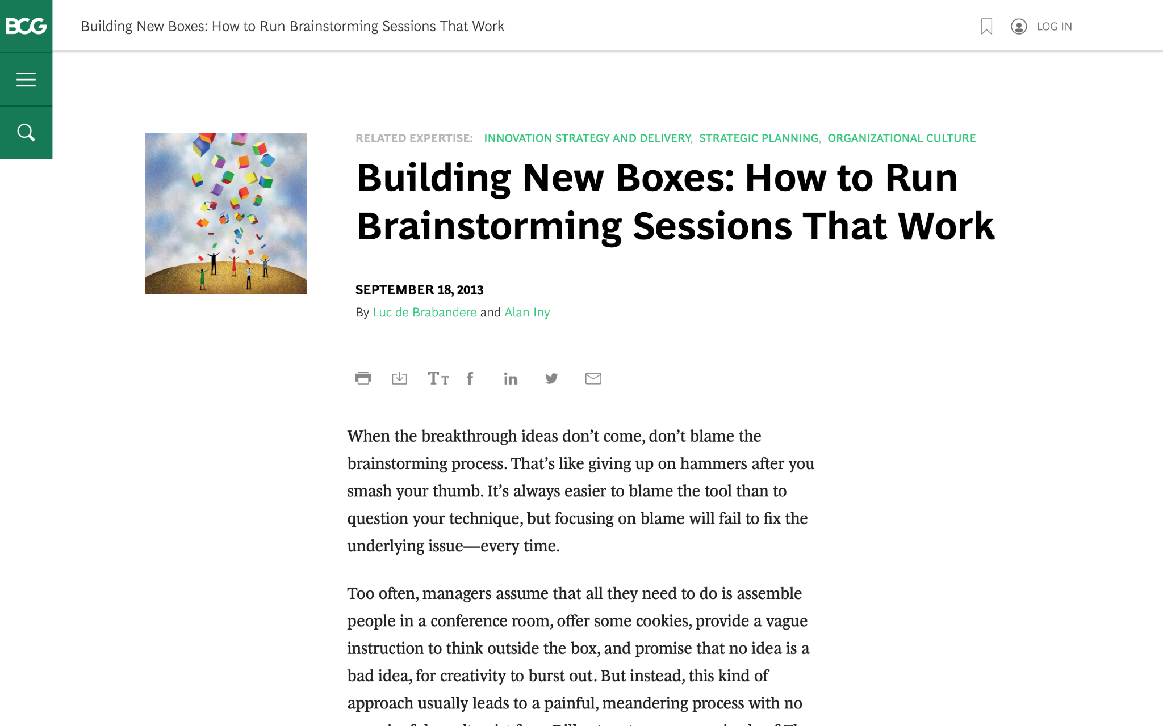
We are going to discuss effective brainstorming. Start by reviewing this article on the BCG website:
Building New Boxes: How to Run Brainstorming Sessions That Work

Slide 3

The article offers five suggestions to achieve real, valuable insights from brainstorming
We will focus on three of these in today’s task (as well as the brainstorming itself), highlighted in green
1.
Frame the question effectively
2.
Create creativity conditions
3.
Reveal and doubt your boxes
4.
Bring new boxes
5.
Follow up
Brainstorm

Slide 4
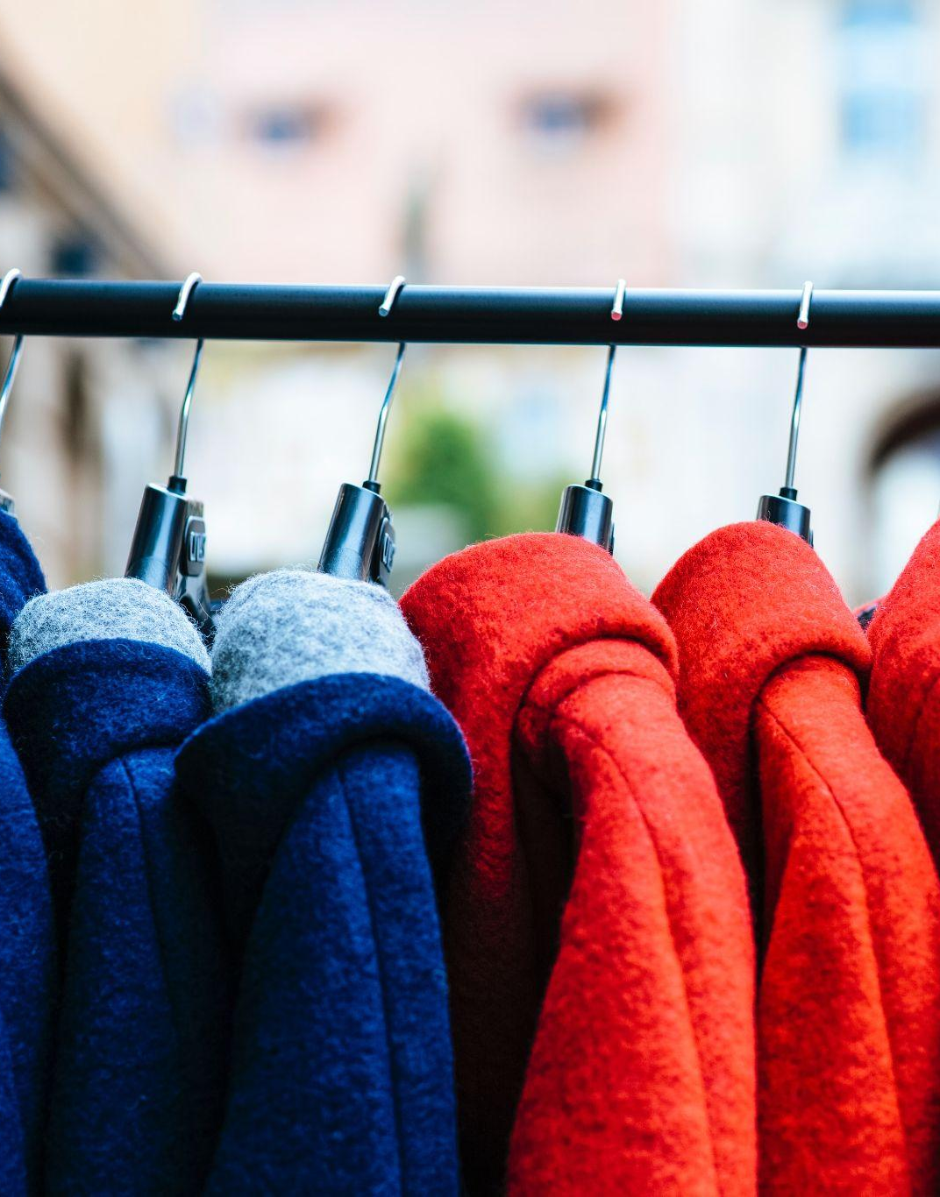
Your task
BCG has been brought in to help ClothingCo, a luxury clothing brand, grow their top line (i.e., increase revenue) after a period of declining sales.
The client is gearing up for the winter season. Imagine that you are a strategy consultant working on the project.
You will enter your responses in the green boxes throughout the remaining slides.

Slide 5
Frame the question effectively
Question to be reframed
How could we sell more outerwear this winter season?
In what ways have consumer preferences and behaviours towards outerwear evolved in the recent past?
Revised, effective questions:
What factors for decline in sales previous season?
How has consumer behaviour and preferences changed recently?
What is the current competition like in the market and how are they performing?
What are our differentiating factors and USPs
Remember: A good question for brainstorming will be narrow and concrete, so that people feel they know how to begin answering it.
“If I were given one hour to save the planet, I would spend fifty-nine minutes defining the problem and one minute resolving it.”
– Albert Einstein

Slide 6
Reveal and doubt your boxes
In this fictional scenario, make assumptions that seem reasonable
Clothing market is not affected by any external scenarios
What boxes currently exist that are still relevant?
Selling on online and offline channels
Quality and craftmanship
Innovation and Creativity
Customer-Centric Approach
What boxes currently exist that need to be doubted?
Make cloths for everyone
Variety in price range
Ratio of technology and handmade
The first step in the creative process entails identifying and doubting one’s current boxes and determining which ones require re-evaluation or replacement.
Make a short list of the shared beliefs and assumptions that likely prevail in ClothingCo. Determine which are still relevant and which need to be redefined.

Slide 7
Bring new boxes
New box #1
[Youth Centric Brand]
Since India is growing market with increasing mid and upper mid class which increases purchasing power. Also median age in India is around 30.
So to cater the needs of young India we should pivot the business to youth centric clothing items which will not just limit to cloths instead it will include accessories such as caps, belts, bracelets etc.
Pivoting the brand will results in using resources well, instead of brainstorming designs and needs for all, a more focused approach will generate better profits
New box #2
[Use of Technology]
A handicraft item might have exited some ages but youth needs funky and flashy clothes. These can easily be made using machines.
With the fast changing fashion, we need to incorporate tech to cope up with the rapid changes. Quick adaptation and manufacturing is required.
For youth designs and comfort matter more than the durability, so there is no need to invest in making durable cloths. Machine based products with decent quality at a reasonable pricing is what they want.
Prepare for brainstorming by creating new boxes to bring to the session; new boxes will nurture ideation and can dramatically increase the odds of a useful result.
Remember: Defining new boxes requires a mixture of analysis and art. Boxes need to be grounded in fact. Different sectors will call for different inputs.

Slide 8
Brainstorm
Choose one of the effective questions you created on slide 5, and a new box from slide 7, and brainstorm potential ideas to address the question
Question | How has consumer behaviour and preferences changed recently?
New box | Use of Technology
Provide more variety in designs and colors
Designs over durability is preferred
Providing value-based shopping prices
Develop good customer support
Adding try on feature on app and website
Collabs with other brands
Influencer marketing through well known social media stars
Concept of Omnichannel shopping
Speed and convenience in e-commerce
Building a good social media reach and presence
Launch high-school ambassador/sales program

